Slide 1
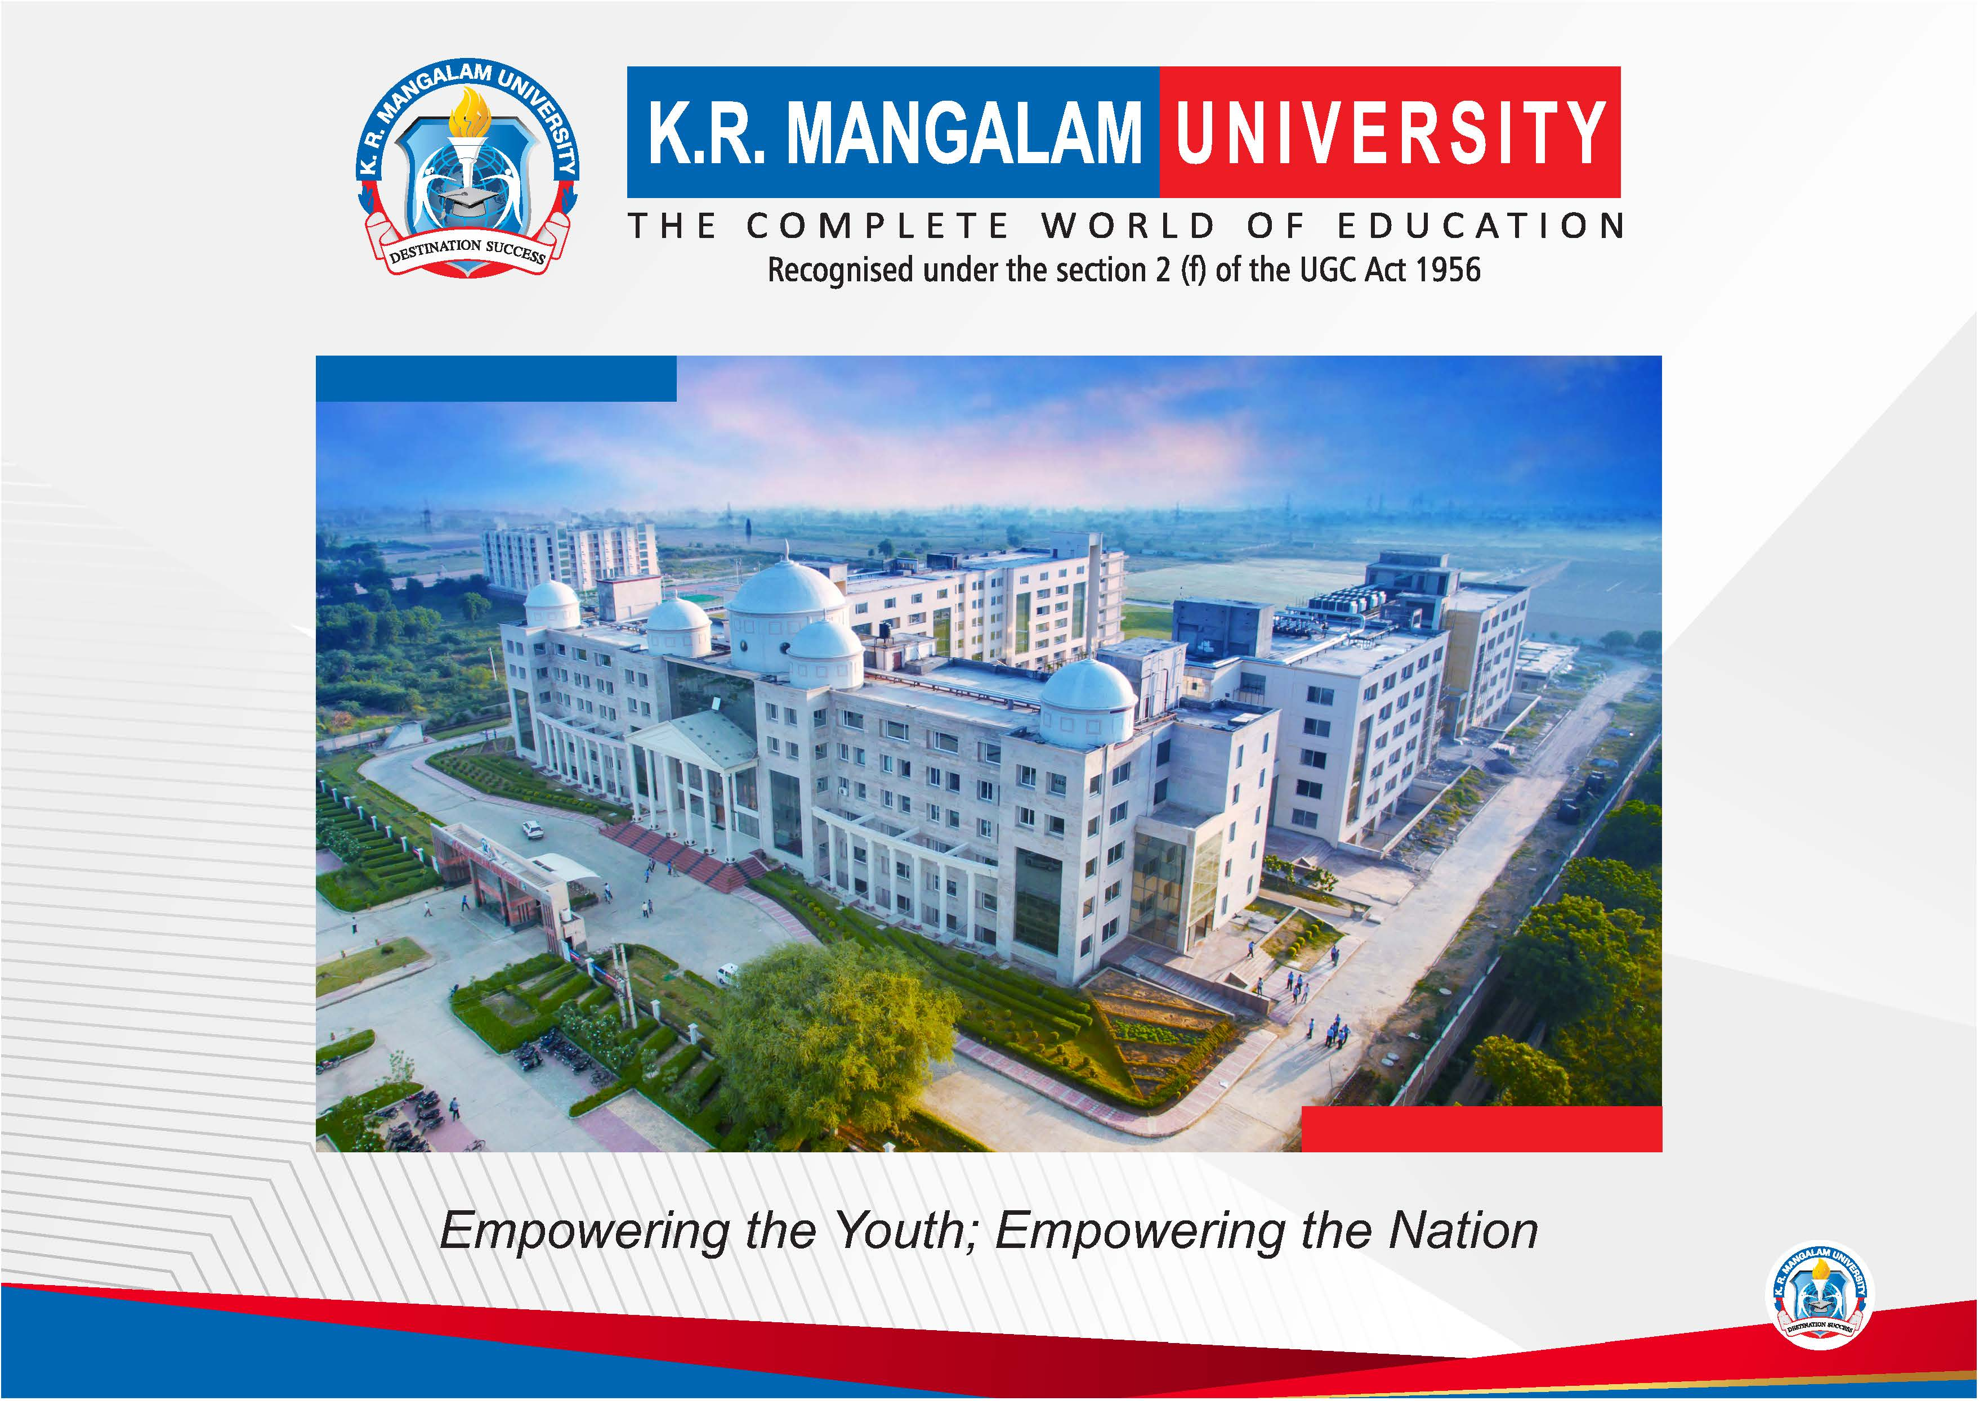

Slide 2


PixelCraft
First Year Project Synopsis
Submitted by
ROLL | NAME
2301560004 | Gagandeep
2301560026 | Priyanshu Dahiya
2301560049 | Vinay Kumar
2301560054 | Cherish Saini
Industry Mentor:
Faculty Mentor:
Notes:
New Courses replaced with New Programmes

Slide 3

Project Overview
The project aims to develop a web application using HTML, CSS, JavaScript, and Python for image background removal and image-to-sketch conversion. Users can upload images through the interface, which are processed in the backend using Python libraries like OpenCV and PIL. The application offers real-time previews of processed images and allows users to adjust parameters for customization. It provides intuitive controls for seamless interaction and a visually appealing interface with CSS styling.
The backend server, implemented with Flask or Django, handles image processing tasks and returns the results to the frontend. The application caters to various domains requiring image manipulation, such as photography, graphic design, and digital art. With a focus on user experience and technical efficiency, the project aims to offer a comprehensive solution for versatile image processing needs.
Notes:
New Courses replaced with New Programmes

Slide 4
Specific Objectives
The specific objective of the project is to develop a web-based tool for image processing, focusing on two key functionalities: background removal and image-to-sketch conversion. This tool will utilize HTML, CSS, JavaScript, and Python to provide a seamless user experience. The objective includes implementing algorithms for accurate background segmentation and creative sketch generation. The tool will feature an intuitive interface allowing users to upload images and adjust processing parameters. Real-time previews will enable users to visualize the effects of their adjustments instantly.
The objective also involves optimizing the backend processing using Python libraries like OpenCV and PIL for efficient image manipulation. Additionally, the tool aims to cater to diverse user needs in domains such as photography, graphic design, and digital art. The project's specific objective is to deliver a user-friendly and versatile image processing solution for various applications.
Notes:
New Courses replaced with New Programmes

Slide 5
Key Features
1. User-Friendly Interface: The tool will boast an intuitive interface that simplifies the image processing experience for users of all skill levels.
2. Background Removal: Advanced algorithms will ensure precise background segmentation, allowing users to seamlessly isolate subjects from their backgrounds.
3. Image-to-Sketch Conversion: The tool will employ sophisticated techniques to transform images into sketch-like representations, offering creative possibilities.
4. Export Options: Processed images can be exported in various formats (e.g., JPEG, PNG) to ensure compatibility with different platforms and applications.
5. Cross-Platform Compatibility: The tool will be accessible across different devices and operating systems, enhancing its usability.
6. Performance Optimization: Backend processing will be optimized using Python libraries like OpenCV and PIL to ensure efficient image manipulation.
Notes:
New Courses replaced with New Programmes

Slide 6
Project Usecases & Scope
1. E-commerce Product Photography: Users can remove backgrounds from product images to create clean and professional product listings.
2. Digital Art: Artists can transform digital images into sketch-like representations for creative expression and experimentation.
3. Advertising: Advertisers can create visually captivating ads by removing backgrounds and adding artistic sketch effects to images.
4. Photo Editing: Casual users can use the tool for fun and creative photo editing, exploring various background removal and sketch conversion options.
5. Educational Use: Students and educators can utilize the tool to learn about image processing techniques such as background removal and sketch conversion.
6. Social Media: Users can enhance their social media posts with visually appealing images created using the tool's background removal and sketch conversion features.
Notes:
New Courses replaced with New Programmes

Slide 7
Prototype/Project Flow diagram/Architecture
+--------------------------------------+
| User Interface |
+--------------------------------------+
|
v
+--------------------------------------+
| Frontend (HTML, CSS, JS) |
+--------------------------------------+
|
v
+--------------------------------------+
| Backend (Python with Flask) |
+--------------------------------------+
|
v
+--------------------------------------+
| Image Processing (OpenCV, PIL) |
+--------------------------------------+
Notes:
New Courses replaced with New Programmes

Slide 8
Data & Resources
OpenCV Library: OpenCV is an open-source computer vision and image processing library that provides various algorithms and functions for tasks like image manipulation, object detection, and feature extraction. We are find documentation and tutorials on the official OpenCV website: [OpenCV Documentation](https://docs.opencv.org/).
Python Imaging Library (PIL): PIL is a library for Python that adds support for opening, manipulating, and saving many different image file formats. It provides a range of image processing capabilities. We can find more information about PIL and its usage in the Python Imaging Library Handbook: [PIL Handbook](https://python-pillow.org/handbook/index.html).
Flask Framework: Flask is a lightweight Python web framework that provides tools and libraries for building web applications. It's easy to use and well-documented. We can find tutorials and documentation on the Flask website: [Flask Documentation](https://flask.palletsprojects.com/en/2.1.x/).
Notes:
New Courses replaced with New Programmes

Slide 9
Data & Resources
HTML, CSS, JavaScript: These are the fundamental languages for building web interfaces. We find tutorials and resources for learning HTML, CSS, and JavaScript on websites like W3Schools: [W3Schools](https://www.w3schools.com/).
Sample Image Dataset: We are use publicly available image datasets for testing and training your image processing algorithms. Websites like Kaggle and Open Images provide various datasets for different tasks: [Kaggle Datasets](https://www.kaggle.com/datasets) and [Open Images Dataset](https://storage.googleapis.com/openimages/web/index.html).
Online Image Editing APIs: There are also online image editing APIs available that you can integrate into your project for additional functionality. APIs like Remove.bg for background removal and DeepArt for artistic image transformations provide easy-to-use services: [Remove.bg API](https://www.remove.bg/api) and [DeepArt API](https://deep-art.io/api).
Notes:
New Courses replaced with New Programmes

Slide 10
Methodology
1. Problem Analysis: Identified the specific requirements and challenges associated with background removal and image-to-sketch conversion.
2. Literature Review: Conducted a comprehensive review of existing literature and research in image processing techniques, focusing on algorithms for background removal and sketch generation.
3. Algorithm Selection: Selected appropriate algorithms based on their suitability for the tasks, including color segmentation, edge detection, and texture synthesis.
4. Tool Evaluation: Evaluated various tools and technologies for implementing the selected algorithms, prioritizing those that offered efficiency and accuracy.
5. Implementation: Implemented the selected algorithms using Python programming language and relevant libraries such as OpenCV and PIL.
Notes:
New Courses replaced with New Programmes

Slide 11
Methodology
6. Testing and Validation: Conducted rigorous testing to ensure the correctness and effectiveness of the implemented algorithms, including both unit testing and integration testing.
7. User Interface Design: Designed an intuitive user interface using HTML, CSS, and JavaScript to facilitate user interaction with the image processing functionalities.
8. Integration: Integrated the backend image processing algorithms with the frontend user interface to create a seamless web application.
9. Optimization: Optimized the algorithms and codebase for efficiency and performance, considering factors such as processing speed and resource utilization.
10. Documentation and Deployment: Documented the methodology, algorithms, and implementation details for future reference and deployed the web application for real-world use.
Notes:
New Courses replaced with New Programmes

Slide 12
Expected Results & Impact
Notes:
New Courses replaced with New Programmes

Slide 13
THANK YOU

